Slide 1


Radial Basis Function Networks: Applications

Slide 2
Applications
Engineering
Time series prediction
Optical Character Recognition
Medicine
PD diagnosis from voice samples
Brain Computer Interface using RBF network

Slide 3
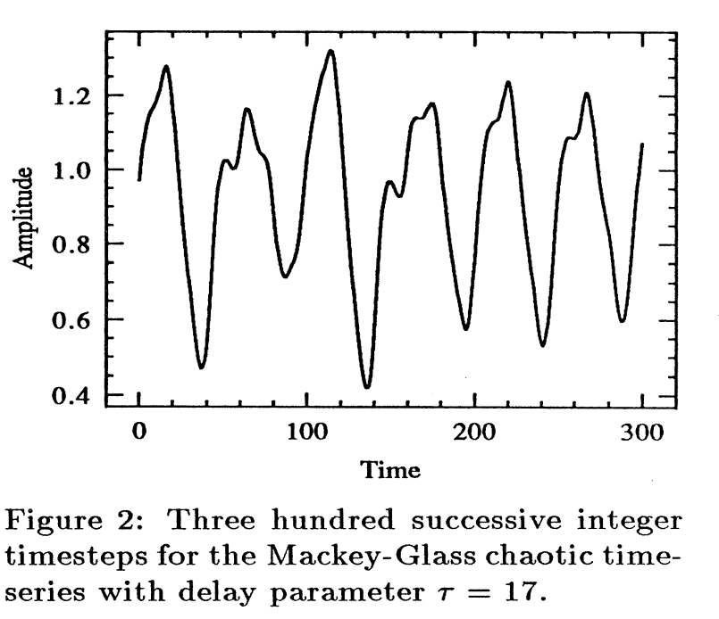
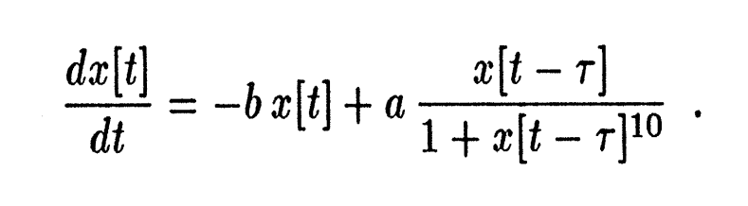
Time series prediction
Mackey-Glass time series prediction
Chaotic time series
Tau = 17; a=0.1; b=0.2
Moody and Darken, Fast Learning in Networks of Locally-Tuned Processing Units, Neural Computation 1, 281-294 (1989)

Slide 4
Time series prediction
History of K points
?
X_{n-k-1}
X_{n-1}
X_{n}
X_{n+1}
K=4, in this case

Slide 5
Learning algorithms
1) Nearest neighbor predictor:
For a given unknown input vector, pick the nearest inp vector in the training set, and return the corresponding output as the prediction

Slide 6
Learning algorithms
2) Adaptive receptive fields (1 RF per training data point)
RBF network
Centroids: with one training data point per centroid
Widths: nearest neighbor distance
Weights: Least Mean Square rule

Slide 7
Learning algorithms
3) Adaptive receptive fields (1 RF per 10 training data points)
RBF network
Centroids: randomly selected from training set, which is 10 times larger than the number of centroids
Widths: nearest neighbor distance
Weights: Least Mean Square rule

Slide 8
Learning algorithms
4) Self-organizing receptive fields
RBF network:
Centroids: K-means on training set, which is 10 times larger than the number of centroids
Widths: nearest neighbor distance
Weights: Least Mean Square rule

Slide 9
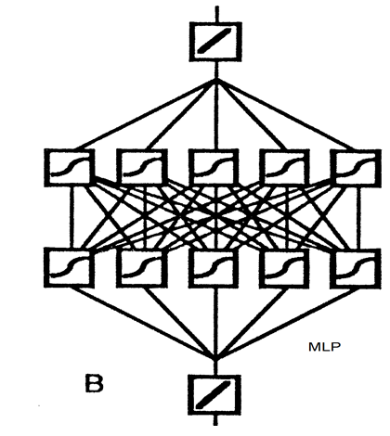
Learning algorithms
A) Backpropagation: 2 hidden layers, 20 neurons each

Slide 10
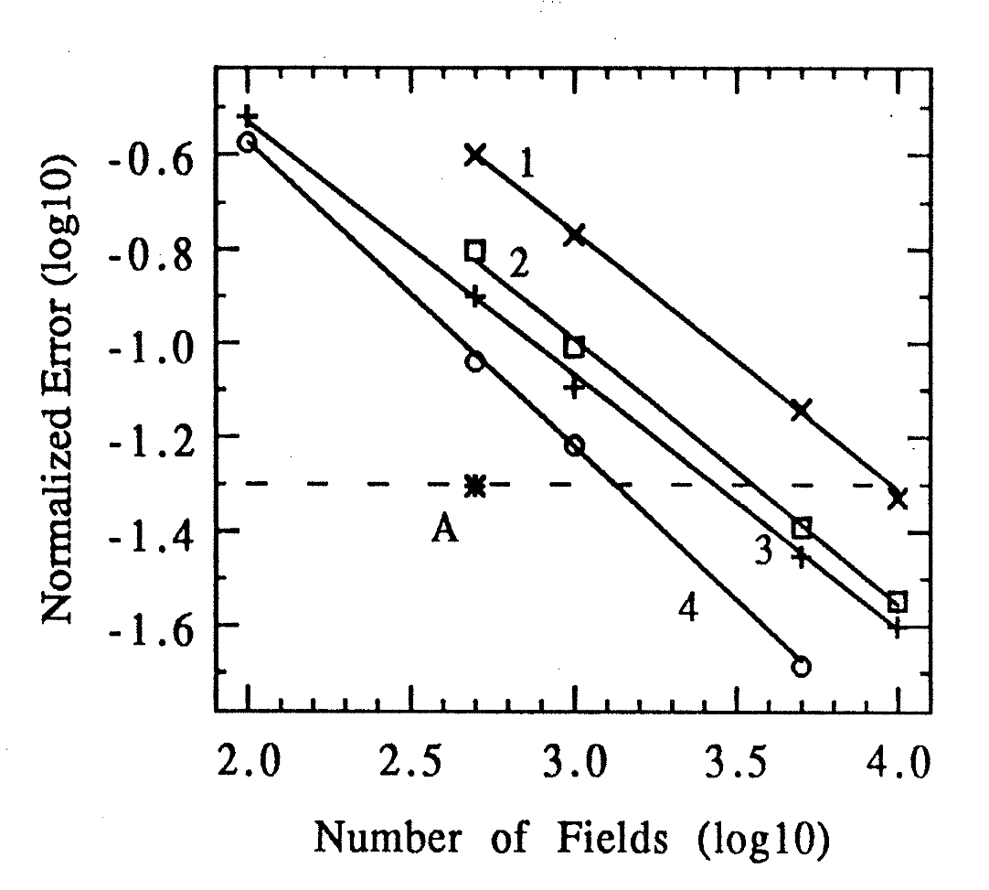
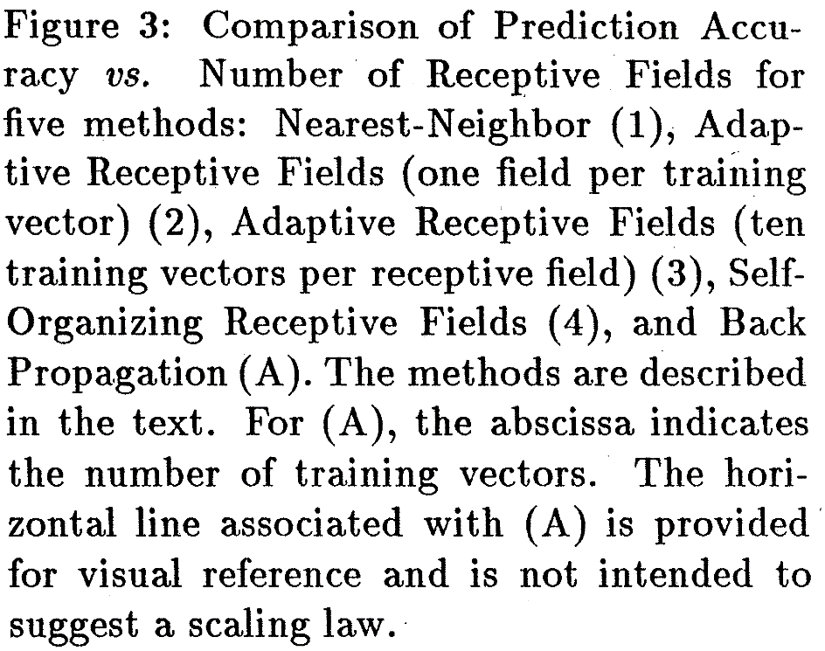
Error performance

Slide 11
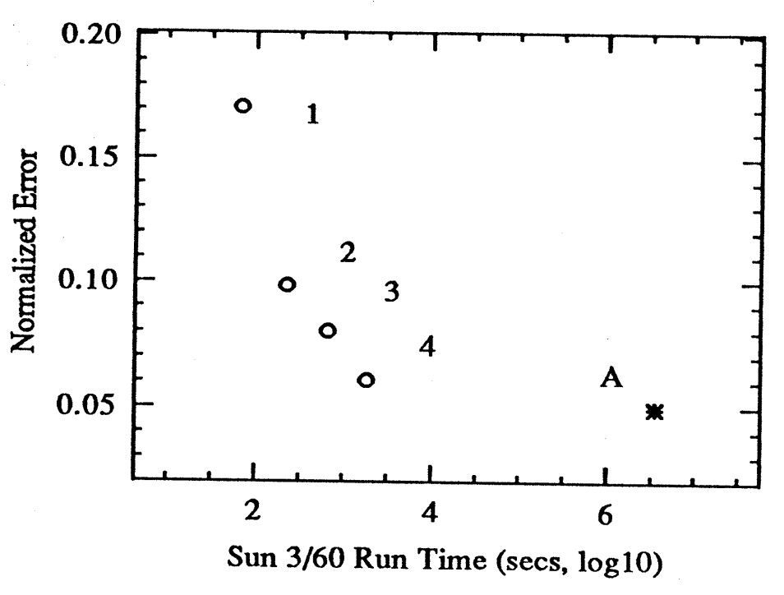
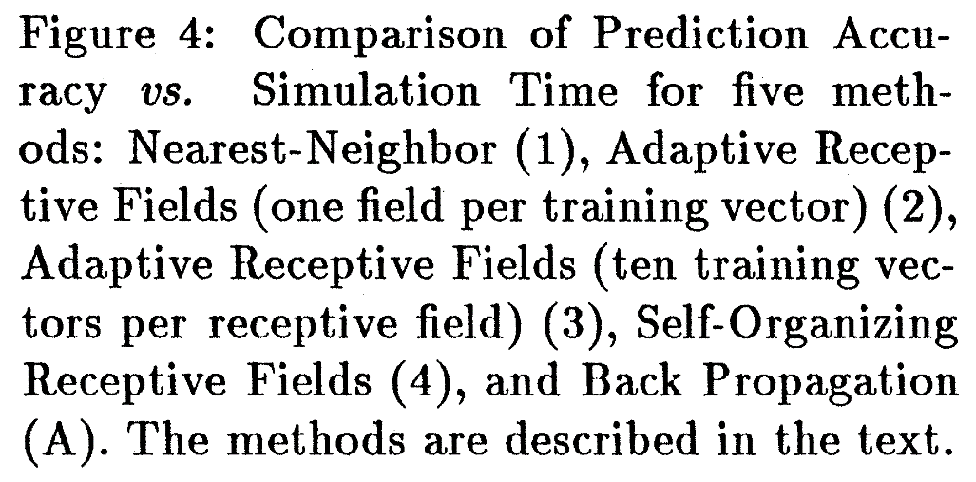
Learning Time

Slide 12
Optical Character Recognition in Tamil using RBF Neural Network
Aparna and Chakravarthy, A Complete OCR System for Tamil Magazine Documents, Chapter in
Guide to OCR for Indic Scripts, 2010.

Slide 13
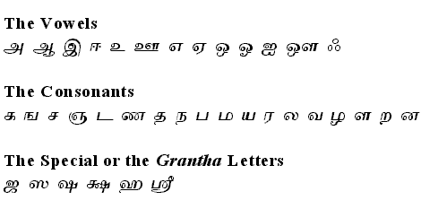
Tamil Characters
145 isolated structures = 135 short + 10 long

Slide 14

RBF network
‘a’

Slide 15
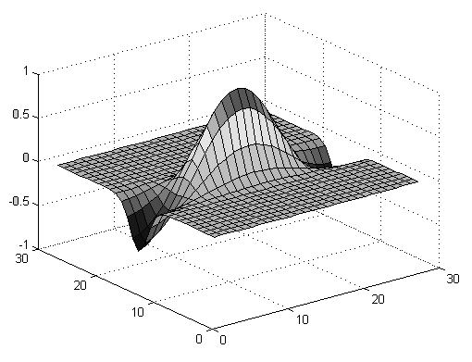
Feature Extraction-Gabor filters
Top View
Notes:
Very useful in feature extraction.
Explain the line segment in the same orientation funda.

Slide 16
Properties of Gabor functions
Gaussians modulated with a cosine.
localized properties in both spatial and frequency domain.
Extract image information necessary for recognition
Are known to emulate receptive fields of Human Visual System

Slide 17
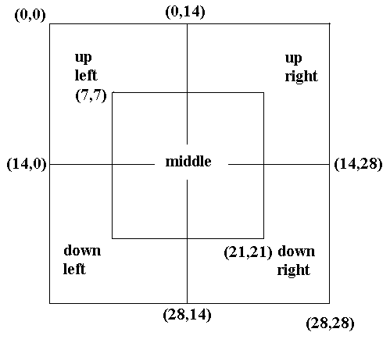
Segments for Gabor Layout
The Primary and Auxiliary segments.
The middle segment is the Primary one.
The rest are the Auxiliary ones.

Slide 18
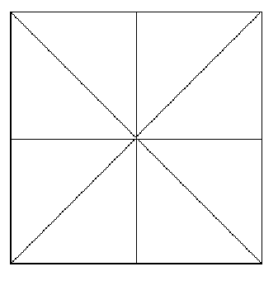
The Actual Layout
Primary Segment
The first figure gives the layout in the Auxiliary segment.
The second one gives the layout in the Primary segment.
We have 32 features totally.
Peripheral Segment

Slide 19
Architectural Details
Number of input nodes = 32
Number of hidden nodes = 150
Number of output nodes = 135
Basis Gaussian Sigma = 5.0

Slide 20
Training the Network
Training Data:
Generate a large number of samples by translation, noise-addition etc.
Training:
non-iterative.
Fast

Slide 21
Training the Network (Contd.)
A different method of training is adopted for each layer.
For the input layer we use a k-means clustering algorithm .
The hidden layer is trained using p-nearest neighbors method.
The output layer is trained using approximate inverse methods like pseudoinverse.

Slide 22
NN for Tamil OCR – I/O
RBF NN
For
Tamil OCR
135 NN
outputs
32 Gabor
Features

Slide 23
Conclusion
The network with the stated architecture gives an accuracy level of 94%.
The errors occur in the characters with minute structural differences.
RBF neural networks take a short time for training.

Slide 24
Medical applications

Slide 25
Diagnosing PD using RBFNN
Objective: Diagnose PD based on Voice data from the patients
Yavuz DELCAN, Lale ÖZYILMAZ, Tülay YILDIRIM, Evolutionary Algorithms Based RBF Neural Networks For Parkinson s Disease Diagnosis, 2011 7th International Conference on Electrical and Electronics Engineering, 1-4 December, Bursa, TURKEY.

Slide 26
Data
The Parkinson database used in this study is taken from the University of California at Irvine (UCI)
The dataset is composed of a range of biomedical voice measurements from 31 people, 23 with PD.
Each column in Table 1 is a particular voice measure, and each row corresponds to one of 195 voice recordings of these individuals.

Slide 27
Training algorithms
Used evolutionary algorithms to train RBF parameters:
Genetic algorithm
Particle Swarm Optimization algorithm
Artificial Bee Colony algorithm

Slide 28
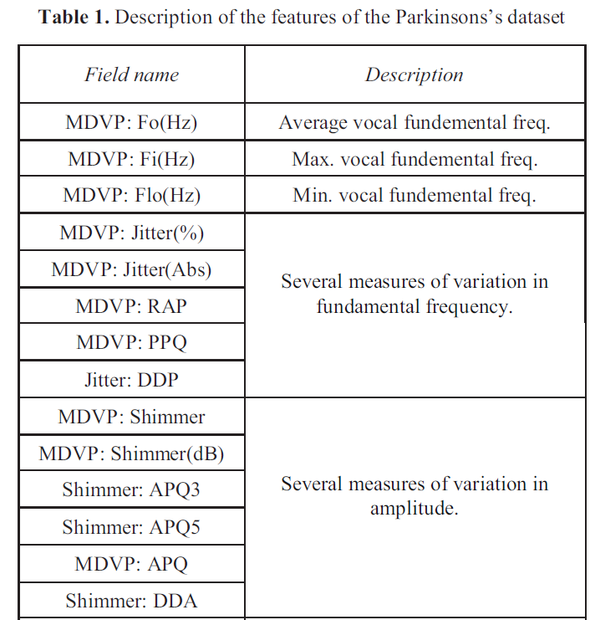
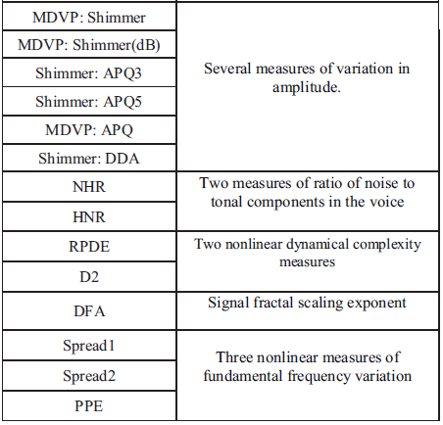
Features = 23

Slide 29
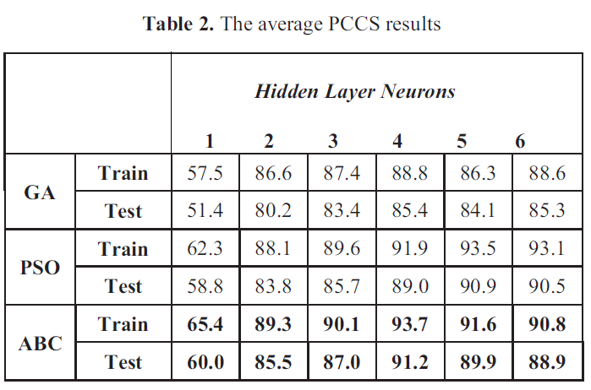
Results

Slide 30
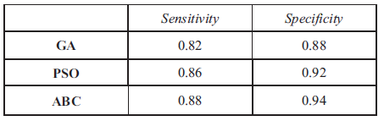
Sensitivity and Specificity

Slide 31
Conclusions
Artificial Bee Colony based RBF neural networks with 4 neurons yielded the best score either in terms of accuracy or speed.
Best training accuracy: 93.7% and
Best test accuracy: 91.2%
Classification or Parkinson’s disease diagnosis

Slide 32
RBF network for Brain Computer Interface (BCI) application
Hamedi, M., Salleh, S. H., Noor, A. M., & Mohammad-Rezazadeh, I. (2014, April). Neural network-based three-class motor imagery classification using time-domain features for BCI applications. In 2014 IEEE Region 10 Symposium (pp. 204-207). IEEE.

Slide 33
BCIs
BCIs refer to the technology by which signals from the brain are directly picked up and used to control an external device
They are useful for people who are seriously challenged in generating movement e.g., paralytics.

Slide 34
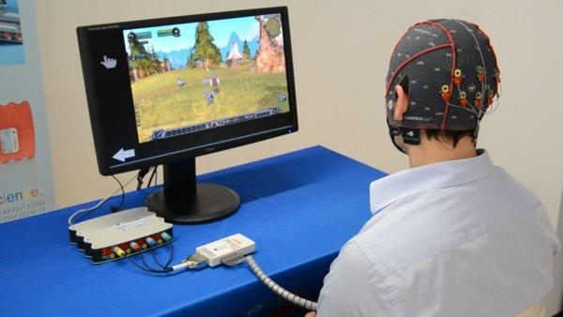

Slide 35
Electroencephalogram (EEG)
EEG is electrical activity of the brain picked by placing electrodes on the scalp
Activity is divided into several frequency bands: delta (< 4Hz), theta (4-7 Hz), alpha (7-13Hz), beta (14-30 Hz), gamma (> 30 Hz)
Low spatial resolution and high temporal resolution

Slide 36
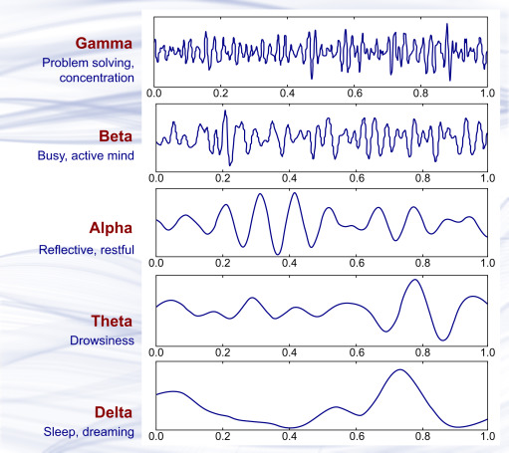

Slide 37
Motor Imagery
Even when a person does not move his/her hand, imagined movement of the hand produces characteristic changes in brain’s activity
Can be picked up from EEG activity
Classifying motor imagery from EEG is an important problem in BCI literature

Slide 38
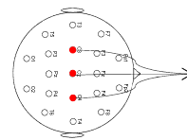
Data collection
Subjects were asked to imagine movement of 1) right hand, 2) left hand and 3) tongue for 1 minute
Followed by a rest period of 5 minutes
3 EEG electrodes

Slide 39
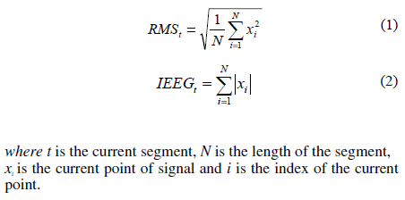
Data preparation
EEG Data divided into bins of 256 ms duration. Sampling rate = 512 Hz
Two features are computed:
RMS:
Integrated EEG:

Slide 40
Classifiers
RBF network
MLP

Slide 41
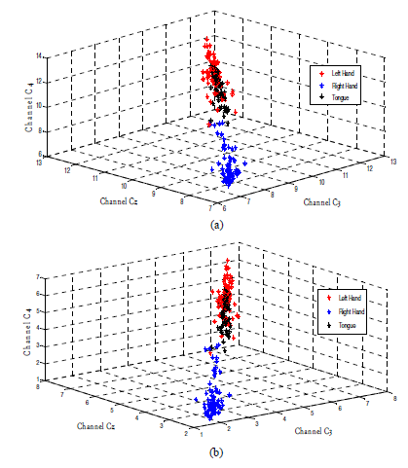
IEEG
RMS

Slide 42
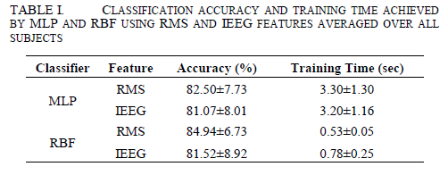
Results

Slide 43
Conclusions
Classification of Motor Imagery data from EEG, is attempted using neural networks
RBF performed better than MLP
Limitations:
Models are poorly described
Data collection can be improved
Time dimension is not considered

